Slide 1


Catching ⬆️
The (Baseline) Unicode Plan for C++23
ThePhD | @thephantomderp | phdofthehouse@gmail.com
https://linkedin.com/in/thephd | https://thephd.github.io | https://github.com/ThePhD

Slide 2

The Year is 2019
And Unicode in C++…

Slide 3
… really bites the dust.
std::wstring_convert needed to be pulled
Caused great harm to performance;
poorly implemented (thanks, std::locale!)
Generally, codecvt / facets are terrible
Virtual interfaces
No data polymorphism or data type extensions

Slide 4

Pain Points
What makes text conversion hard?

Slide 5
Conflating Locale + Encoding ☹
Save a non-ASCII file in Germany, ship it to Japan
Cry bitter tears when the bug reports roll in
Use /utf8 in MSVC
Forget to save your file as UTF8 in the editor, cry bitter tears
Ship code to platform you don’t own
Locale is different: wonder why no bug is reproducible

Slide 6
“What is the Encoding?”
char
whatever system feels like!
LANG, setlocale, Active Code Page, computer location, …
wchar_t
UTF16 Windows/IBM, UTF32 not-Windows…
… maybe! UTF32 for IBM platforms at 64-bit, UTF16 otherwise.
… exception for Chinese locales, where it’s some flavor of Big5 or GBK or something!
Notes:
Windows is UCS-2 for almost all C and C++ wchar_t library functions (!!)

Slide 7

“Well we have Unicode Literals!”
Nope: beholden to macros.
char16_t: __STD_C_UTF16__
char32_t: __STD_C_UTF32__
Fixed in C++20 (p1041 – Make char16/32_t UTF16/32)
thanks, Robot!

Slide 8
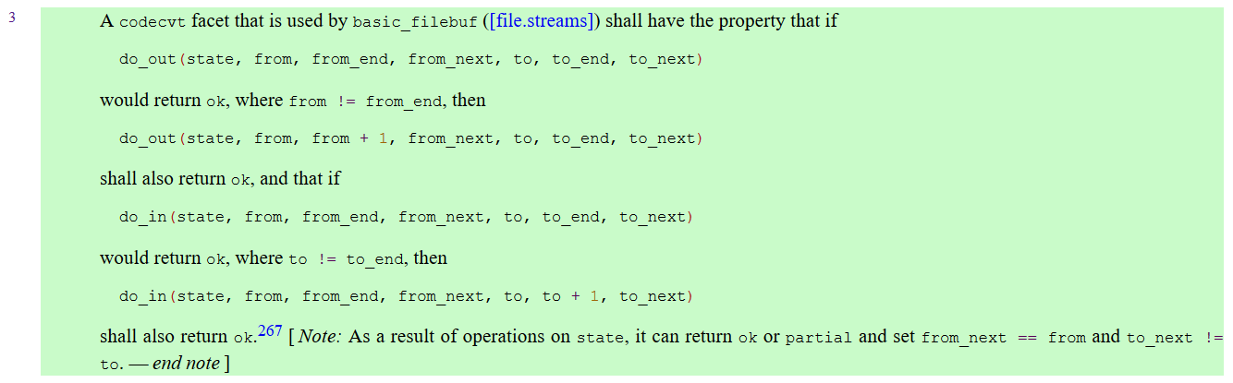
“Okay, but C++ streams are—”
No.
wchar_t still horrible even with “multiple code units” allowed in streams!
basic_filebuf is restricted to 1:1 conversion for all in/output code units [locale.codecvt.virtuals#3]

Slide 9
There is no way to fix C++ streams
Can remove restrictions…?
What about APIs that depended on this upstream?
Risky as all get-out (silent, still-compiling change)
Virtual function hell
Non-virtual functions have bad interface…!
Current landscape status: pretty hosed

Slide 10
C is no better
Singular code unit conversion functions
mb(r)towc, wc(r)tomb, c8/16/32rtomb, mbrtoc8/16/32
Explicitly wrong for multibyte encodings (e.g., anything that is not UTF32-alike)
“r” means “restartable”; preserves state between calls, potentially helpful for multi code unit encodings (UTF8, UTF16).
Multi code unit conversion functions
Do not exist for c8/16/32…

Slide 11
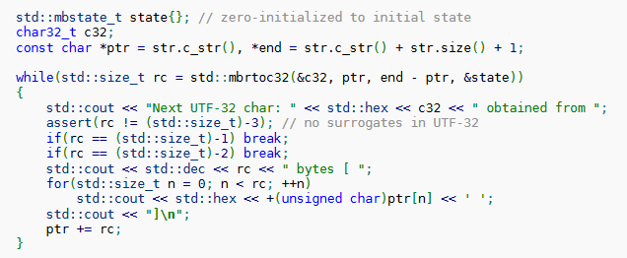
Well, just loop!
How hard can it be? It’s C! We’ve got…
Pointers!
Error codes!
No exceptions!
Easy 😎

Slide 12
🐌

Slide 13
🐌Slow🐌
No SIMD possibilities
Potentially hard compiler barrier for being in a DLL; no chance to vectorize
Restartable versions, even though the conversion might not be stateful
And the API? Well…

Slide 14
[[digression]]
namespace std { int mbtowc( wchar_t* pwcs, const char* mbs, size_t num
); }

Slide 15
[[digression]]
Stop using pointers to represent optional values in interfaces.
wchar_t* is supposed to be a wide string
But it’s a pointer to a single, optional wchar_t instead
Conventions are great!
Until they are wrong.
C gets a pass: C++ interfaces don’t.
Don’t use pointers for optional values in C++ interfaces.

Slide 16
[[end digression]

Slide 17
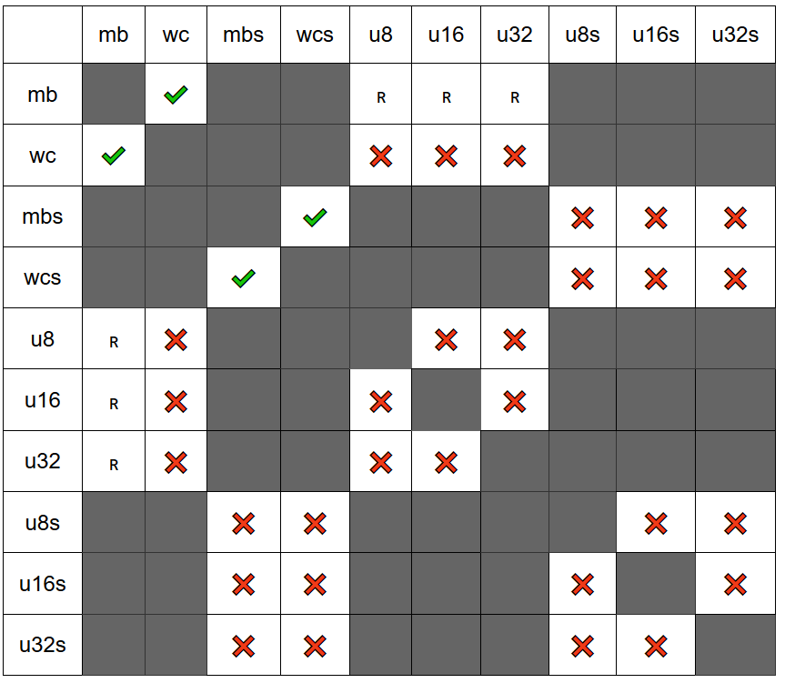
Critically Missing APIs
{column}(r)to{row}
mbsrtoc8s
Null terminated source strings too
Need sized versions

Slide 18
Fine. Fine! C and C++ are terrible.
But we have third party libraries!
Notes:
N2245: to add 2 functions for char16/32_t multi-unit conversions (non-restartable only)

Slide 19

:joy:

Slide 20
More Seriously…
ICU has, and likely will always be, sort of a 🗑️🔥 in terms of API
Still the most fully featured
Hand-optimized by many experts
Several ad-hoc libraries for conversion, but lacking the chops to do the Unicode algorithms
Various states of maintenance

Slide 21


Current Libraries
Boost.Text
From prominent boost contributor Zach Laine
Handles encoding, decoding, and many higher-level Unicode algorithms
Bidi, Segmentation, Collation, …
libogonek, text_view
Libraries from Robot M. Fernandes and Tom Honermann, respectively
Handle encoding / decoding (libogonek has a lot more features)

Slide 22
👍 / 👎
Boost.Text
👍: Covers the widest variety of Unicode algorithms
👍: Uses STL concepts, pretty good speed
👎: Fixed internal representation and normalization forms
libogonek
👍: Provides many Unicode algorithms, including normalization
👍: Concept-driven design with iterators and decent speed
👎: not recently maintained, [iterator, iterator) size blowup

Slide 23
The [iterator, iterator) 💣
ogonek::detail::grapheme_iterator< ogonek::detail::normalize_iterator< ogonek::detail::decode_iterator<…>, …>, …> segmenting_iterator first(…), last(…);
Enormous iterator hierarchy: 256+ byte iterators
Needed begin + end inside decode iterators;
Each iterator was paired with another iterator of the same type;
Lots of state management to not overrun / be safe

Slide 24

std::ranges to the rescue
[decode_iterator, decode_sentinel)
No more book-keeping on both iterators
Separate types

Slide 25

std::ranges to the rescue
[decode_iterator, decode_sentinel)
No more book-keeping on both iterators
Separate types
All information on the iterator half only
Sentinel comparison just checks begin/end iterators inside a single decode_iterator

Slide 26

Other APIs
Firefox / Chrome codebases
👍: Extremely fast
🤏: Pointer-based API, SIMD optimized
👎: (mostly) codebase-specific
Except for Henri Sivonen: wrote encoding_rs
Some APIs are byte-based, some work with code units
A lot of APIs only handle pointers, which exclude exotic storage

Slide 27
Let’s Do Better

Slide 28
The Goal 🥅
#include <text>
#include <iostream>
int main () {
using namespace std::literals;
std::text::u8text my_text = std::text::transcode(
“안녕하세요 👋”sv,
std::text::utf8{}
);
// prints 안녕하세요 👋 to a capable console std::cout << my_text << std::endl;
return 0;
}

Slide 29
std::text::text; a Container Adaptor
namespace std::text { template <typename Encoding, typename NormalizationForm = nfkc, typename Container = std::basic_string<…>, … > class basic_text; }

Slide 30
Similarly; std::text::text_view
namespace std::text { template <typename Encoding, typename NormalizationForm = nfkc, typename Range = std::basic_string_view<…>, … > class basic_text_view; }

Slide 31
Convenience aliases, as usual
namespace std::text { using u8text = basic_text<utf8>; using u16text = basic_text<utf16>; using u32text = basic_text<utf32>; using wtext = basic_text<wide_execution>; using text = basic_text<utf8>; using u8text_view = basic_text_view<utf8>; using u16text_view = basic_text_view<utf16>; using u32text_view = basic_text_view<utf32>; using wtext_view = basic_text_view<wide_execution>; using text_view = basic_text_view<utf8>; }

Slide 32
Reality Check
namespace std::text { using u8text = basic_text<utf8>; using u16text = basic_text<utf16>; using u32text = basic_text<utf32>; using wtext = basic_text<wide_execution>; using text = basic_text<narrow_execution>; using u8text_view = basic_text_view<utf8>; using u16text_view = basic_text_view<utf16>; using u32text_view = basic_text_view<utf32>; using wtext_view = basic_text_view<wide_execution>; using text_view = basic_text_view<narrow_execution>; }

Slide 33
Container/View Adaptors?
Flexible
Expects a SequenceContainer
Works with std::deque<T>, llvm::SmallVector<T>, __gnu_cxx::rope<T>, gap_buffer, …
Cannot afford to reinvent everyone’s API with a new string type!
ICU does it with UnicodeString
Not at all fun

Slide 34
Nothing Changes
// thing.hpp inline std::string do_the_thing(std::string totes_utf8); // thing.cpp std::string do_the_thing(std::string totes_utf8) { // the stuff, manually }

Slide 35
Nothing Changes (for the user)
// thing.hpp inline std::string do_the_thing(std::string totes_utf8); // thing.cpp using my_u8text = std::text::basic_text<basic_utf8<char>>; std::string do_the_thing(std::string totes_utf8) { my_u8text deffo_utf8(std::move(totes_utf8)); // the stuff, better :D return std::move(deffo_utf8.base()); }

Slide 36
The Goal – Networking 🥅
namespace beast = boost::beast; // from <boost/beast.hpp>
namespace http = beast::http; // from <boost/beast/http.hpp>
using tcp = boost::asio::ip::tcp; // from <boost/asio/ip/tcp.hpp>
using results_type = tcp::resolver::results_type;
class session : public std::enable_shared_from_this<session> {
/* … */
http::request<http::empty_body> req_;
std::vector<std::byte> res_body_;
http::response<http::vector_body<std::byte>> res_; std::u8string converted_body_; /* … */ void on_connect(beast::error_code ec, results_type::endpoint_type); void on_resolve(beast::error_code ec, results_type results);
void on_read(beast::error_code ec, std::size_t bytes_transferred); };

Slide 37
The Goal – Networking 🥅
void session::on_read(beast::error_code ec, std::size_t bytes_transferred) {
if (ec) {
log_fail(ec, u8"read failed");
return;
}
std::span<std::byte> bytes(res_body_.data(), bytes_transferred);
/* continued … */ }

Slide 38
The Goal – Networking 🥅
void session::on_read(beast::error_code ec, std::size_t bytes_transferred) {
/* … from previous slide */ std::ranges::unbounded_view output(
std::back_inserter(converted_body_)
);
std::text::encoding_scheme<std::text::utf16,
std::endian::big> from_encoding{};
std::text::utf8 to_encoding{};
// transcode from bytes, into unbounded output
std::text::transcode(bytes, output, from_encoding, to_encoding);
std::clog << converted_body_ << std::endl;
}

Slide 39

Keep this dream in mind…

Slide 40

Digging Deep
Or: “How do we get from here to there?”

Slide 41
Foundation: Encoding objects
Encoding is a concept that a class type can satisfy
It has some required (and optional) operations
Serves as the foundational building block
Encodes and decodes one code point at a time
Member types and static member variables to dictate some useful defaults

Slide 42
Helper Types: Basics
struct empty_struct {}; using u8_span = std::span<char8_t>; using u16_span = std::span<char16_t>; using u32_span = std::span<char32_t>;
enum class encoding_errc : int { ok = 0x00, invalid_sequence = 0x01, insufficient_output_space = 0x02, };

Slide 43
Helper Types: Result Types
struct decode_result { u8_span input; u32_span output; empty_struct& state; encoding_errc error_code; };
struct encode_result { u32_span input; u8_span output; empty_struct& state; encoding_errc error_code; };

Slide 44
Helper Types: Error Handlers
using decode_error_handler = std::function_ref< decode_result(utf8&, decode_result) >; using encode_error_handler = std::function_ref< encode_result(utf8&, encode_result) >;

Slide 45
An example encoding object
struct utf8 { using code_unit = char8_t; using code_point = char32_t; using state = empty_struct; using is_decode_injective = std::true_type; using is_encode_injective = std::true_type; static constexpr inline std::size_t max_code_points = 1; static constexpr inline std::size_t max_code_units = 4; encode_result encode(u8_span input, u32_span output, state& current, encode_error_handler error_handler); decode_result decode(u32_span input, u8_span output, state& current, decode_error_handler error_handler); };

Slide 46
(Gory details for the standard)
template <typename _CharT = char8_t> struct basic_utf8 { using code_unit = _CharT; using code_point = char32_t; using state = empty_struct; using is_decode_injective = std::true_type; using is_encode_injective = std::true_type; static constexpr inline std::size_t max_code_points = 1; static constexpr inline std::size_t max_code_units = 4; template <typename __InputRange, typename __OutputRange, typename __ErrorHandler> static constexpr auto encode(__InputRange&& __input, __OutputRange&& __output, state& __s, __ErrorHandler&& __error_handler); template <typename __InputRange, typename __OutputRange, typename __ErrorHandler> static constexpr auto decode(__InputRange&& __input, __OutputRange&& __output, state& __s, __ErrorHandler&& __error_handler); };

Slide 47
An example encoding object
struct utf8 { using code_unit = char8_t; using code_point = char32_t; using state = empty_struct; using is_decode_injective = std::true_type; using is_encode_injective = std::true_type; static constexpr inline std::size_t max_code_points = 1; static constexpr inline std::size_t max_code_units = 4; encode_result encode(u8_span input, u32_span output, state& current, encode_error_handler error_handler); decode_result decode(u32_span input, u8_span output, state& current, decode_error_handler error_handler); };

Slide 48
code_unit
The units that can be composed to create one meaningful point of information
Can take 1 to N code_units to make a single meaningful point of information
UTF8: 1-4 code units, 1-4 bytes
UTF16: 1-2 code units, 2-4 bytes
UTF32: 1 code unit, 4 bytes
ASCII: 1 code unit, 1 byte

Slide 49
code_point
An indivisible unit representing an unambiguous bit of information
Can represent every single indivisible unit of information in the character repertoire
Gb18030, UTF8, UTF16, UTF32: produce 1 code point
ASCII: produces 1 code point (!!)
Generally, represented as char32_t

Slide 50
state
State is used for stateful encodings
E.g., ISO-2022 JP
Can encode “shift states” or “modes” that change how later characters are processed
Trifecta of Unicode Encodings are not stateful
So they are just an empty struct

Slide 51
encode, decode
2 functions which take in an input range, an output range, the current state, and an error handler
Computes exactly one – and only one – indivisible unit of information:
multiple code units ➡️ one code point;
one code point ➡️ multiple code units;
modify state + one of the above;
or, output error

Slide 52
Uh… “output range”?
A better abstraction for handling sized output: safe!
std::u8string input = u8“𐌼𐌰𐌲 𐌲𐌻𐌴𐍃 𐌹̈𐍄𐌰𐌽, 𐌽𐌹 𐌼𐌹𐍃 𐍅𐌿 𐌽𐌳𐌰𐌽 𐌱𐍂𐌹𐌲𐌲𐌹𐌸.”; std::u32string output(16, U‘\0’); std::text::utf8 encoding{}; std::text::utf8::state state{}; auto result = encoding.decode( input, std::span(output), state, std::text::default_handler{} ); // does not overrun buffer

Slide 53
Need speed?
Ask for it with an unbounded view
std::u8string input = u8“𐌼𐌰𐌲 𐌲𐌻𐌴𐍃 𐌹̈𐍄𐌰𐌽, 𐌽𐌹 𐌼𐌹𐍃 𐍅𐌿 𐌽𐌳𐌰𐌽 𐌱𐍂𐌹𐌲𐌲𐌹𐌸.”; std::u32string output(16, U‘\0’); std::text::utf8 encoding{}; std::text::utf8::state state{}; auto result = encoding.decode( input, std::ranges::unbounded_view(output.data()), state, std::text::default_handler{} ); // may overrun buffer

Slide 54
[[dangerous]] Need more speed?
Use the “I’m smarter than you”, UB error handler
std::u8string input = u8“𐌼𐌰𐌲 𐌲𐌻𐌴𐍃 𐌹̈𐍄𐌰𐌽, 𐌽𐌹 𐌼𐌹𐍃 𐍅𐌿 𐌽𐌳𐌰𐌽 𐌱𐍂𐌹𐌲𐌲𐌹𐌸.”; std::u32string output(16, U‘\0’); std::text::utf8 encoding{}; std::text::utf8::state state{}; auto result = encoding.decode( input, std::ranges::unbounded_view(output.data()), state, std::text::assume_valid_handler{} ); // may overrun buffer and explode code

Slide 55
is_(decode|encode)_injective
Communicates whether transformation is lossy
marks a decode/encode(…) operation as being fundamentally lossy
Injective: one-to-one mapping that preserves distinctness
Solves ASCII problem:
ascii has only 1 code unit, 1 code point
cannot represent more than 7 bits of information
U“🐶” – cannot be represented!

Slide 56
is_(decode|encode)_injective
Not used directly in low-level encoding object interface
Used to require error handler for any lossy conversions
static_assert failure when:
encoding/decoding not injective;
code point types of encodings are convertible to one another;
or, encoding/decoding is injective one way, but not another.

Slide 57
Injective properties: safety control
Narrowing is generally evil and causes (subtle) bugs
std::size_t ➡️ int; uint32_t ➡️ int16_t
struct ascii {
// ASCII -> Unicode, fine
using is_decoding_injective = std::true_type;
// Unicode -> ASCII, not fine using is_encoding_injective = std::false_type;
using code_unit = char; /* … */
};

Slide 58
Bad conversion
std::string ascii_emoji = std::text::encode( U“🐶”, std::text::ascii{} );

Slide 59
Bad conversion
std::string ascii_emoji = std::text::encode( U“🐶”, std::text::ascii{} ); // Compiler Error: this is a lossy conversion

Slide 60
Want to Narrow? Be Explicit
std::string ascii_emoji2 = std::text::encode( U“🐶”, std::text::ascii{}, std::text::default_handler{} ); // Compiler Error std::string ascii_emoji3 = std::text::encode( U“🐶”, std::text::ascii{}, std::text::replacement_handler{} ); // … Well, I mean, you asked for it!

Slide 61
Standard Encodings
template <typename Char> class basic_utf8; template <typename Char> class basic_utf16; template <typename Char> class basic_utf32; class ascii; class narrow_execution; class wide_execution; using utf8 = basic_utf8<char8_t>; using utf16 = basic_utf16<char16_t>; using utf32 = basic_utf32<char32_t>;

Slide 62

Beyond the Objects
What simple encoding objects enable?

Slide 63
Need for Speed
Performance is correctness.
No way around it.
3-speed approach
Slowest Path (round-trip transcoding, lazy)
Faster Path (direct transcoding, no round-tripping, lazy)
Fastest Path (bulk processing, eager consumption)

Slide 64
Slowest
Encoded Single Input
Decode → Unicode Code Point
Unicode Code Point → Encode
Encoded Single Output
Works for Everything™
Ideal for disparate encodings
SHIFT-JIS to GB18030 to EBCDIC
Roundtrips through Unicode
Converts one codepoint at a time

Slide 65
Slowest: Explicit Encode, Decode
Roundtrip from encoding to decoding through common code point
One-by-one encoding and checking
Safe, scalable
Uses range types, like std::text::text_view
Take advantage of std::ranges allowing begin/end to be different
Reduces problem of layering iterators

Slide 66
Slowest: lazy transcode_view 🐢
(encode|decode|transcode)_view wraps a wrap a range
takes encoding objects as template parameters (From, To)
Always round-trip converts
std::text::transcode_view<std::string_view,
std::text::narrow_execution,
std::text::utf32 > lazy = “こんばんわ。”; for (char32_t my_utf32_cp : lazy_view) { /* do as you wish */ }

Slide 67
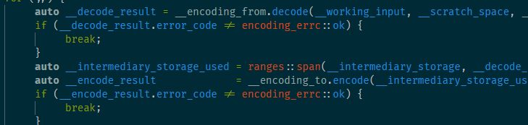
Slowest: a code Snapshot 🐢

Slide 68
Faster Path
Encoded Single Input
Direct Transcode
Encoded Single output
Specific to a direction and a pair of encodings
Ideal for encodings where we know there are fast conversion (UTF8 🔄 UTF32, UTF16 🔄 UTF32, etc.)
Converts directly without necessarily going to an intermediate
One at a time conversion

Slide 69
Faster: text_transcode_one 🐇🏃‍♀️
ADL function a user writes to hook transformation
Allows users to override standard roundtrip behavior
Faster, but not fastest:
Still a one-by-one transformation
Still expects one individual unit of information to be consumed

Slide 70
Faster: text_transcode_one 🐇🏃‍♀️
void text_transcode_one(
u8_span input, u32_span output,
std::text::utf8& input_enc, std::text::utf32& output_enc, empty_struct& input_state, empty_struct& output_state,
decode_error_handler decode_handler,
encode_error_handler encode_handler
) { // just… decode!
(void)output_encoding; (void)encode_handler; (void)output_state; input_enc.decode(input, output, input_state, decode_handler); }

Slide 71
Faster: text_transcode_one 🐇🏃‍♀️
Write one for UTF16 🔄 UTF8, or GB 🔄 GB18030
Important: code still looks the same from before!
std::text::transcode_view<
std::u8string_view, std::text::utf8, std::text::utf32
> lazy_view = u8“🐶 woof!”;
for (char32_t my_utf32_cp : lazy_view) { /* do as you wish! */ }

Slide 72
Fastest Path
Encoded Input
Direct Transcode
Encoded Output
Specific to a direction and a pair of encodings
Bulk transcode converts directly without necessarily going to a code point
Bulk conversion (SIMD, etc.)
Typically done on ContiguousRanges

Slide 73
Fastest: eager function 🏎️
Absolute fastest path
Free functions: encode, decode, transcode
convert as much as possible – not restricted to “one code point at a time”
std::text::u8text my_string = std::text::transcode( u“𐌼𐌰𐌲 𐌲𐌻𐌴𐍃 𐌹̈𐍄𐌰𐌽, 𐌽𐌹 𐌼𐌹𐍃 𐍅𐌿 𐌽𐌳𐌰𐌽 𐌱𐍂𐌹𐌲𐌲𐌹𐌸.”,
std::text::utf8{} );

Slide 74
Fastest: Customization
People outside the standard will have encodings and encoding conversion pairs they care about
Takes pressure of implementers to have to provide amazing QoI
Substitute in proprietary conversions for the 90% cases already optimized for
The rest will still work through the “Faster” and “Slower” paths

Slide 75
Fastest: text_[en/de/trans]code
void text_transcode(
u8_span input, u16_span output,
std::text::utf8, std::text::utf16, empty_struct&, empty_struct&,
decode_error_handler decode_handler,
encode_error_handler
) { std::ptrdiff_t result = UtfUtils::SseConvert(
input.begin(), input.end(), output.begin()); if (result == -1) { decode_handler(…); } }

Slide 76
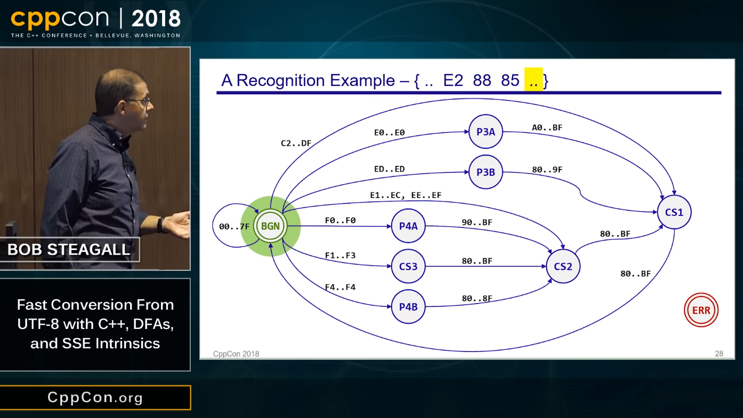
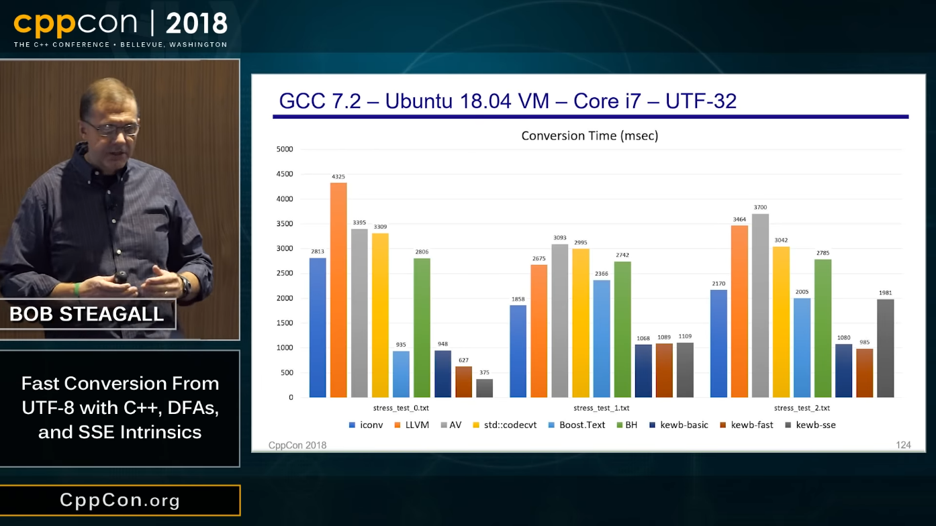
Fastest Path: In your Hands
https://github.com/BobSteagall/utf_utils https://www.youtube.com/watch?v=5FQ87-Ecb-A

Slide 77
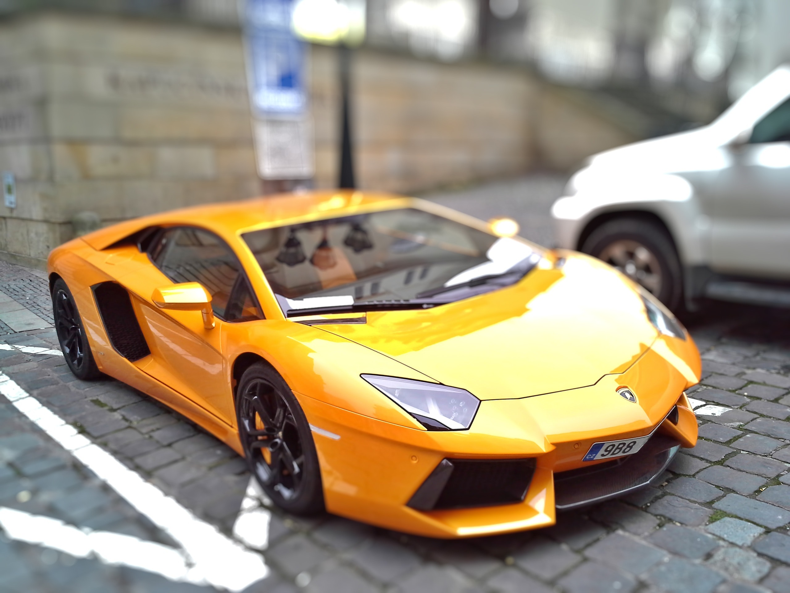
Accelerating Development
This foundational work is needed in C++23 to enable non-experts to write ‘hello 🌎’.
— Tom Honermann Chair, Study Group 16

Slide 78
P1629 – Standard Text Encoding
A way to get the typically digitally underserved, served
Making it simple to perform encoding conversions
P1629 needs an implementation
A lot of work
Current Feel of the Committee: “Library implementation or get out.”

Slide 79
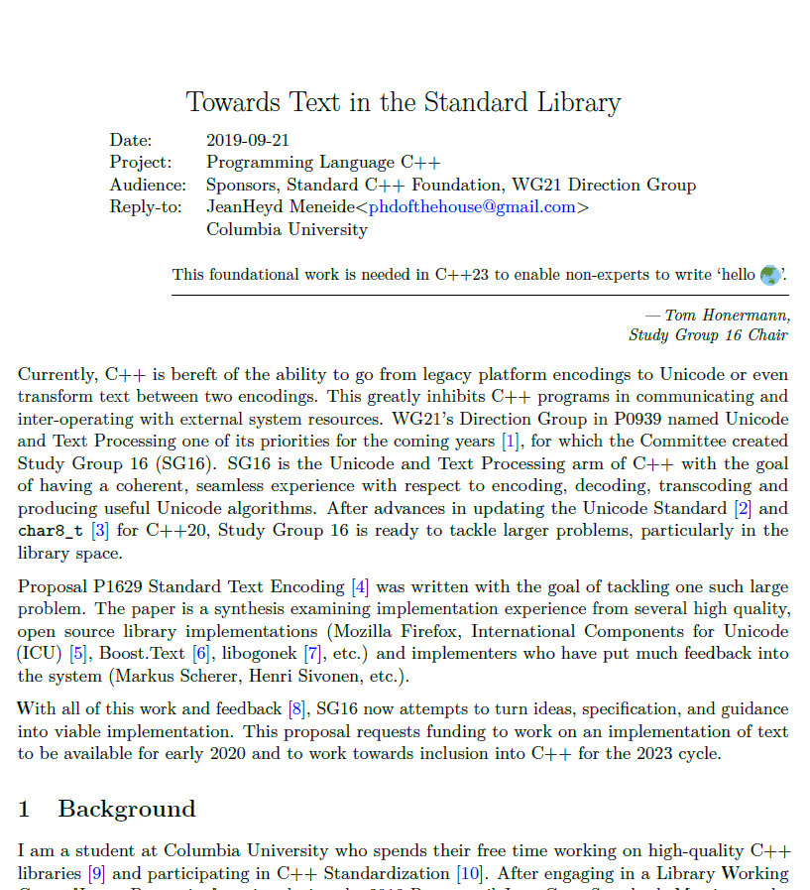
Sponsorship Necessary
Everyone complains about Text and Unicode support
Even if you cannot do the work, you can help fund it.
Goal: extended implementation by 2020
Early in the C++23 cycle

Slide 80



Join us online, at the mailing list, in our repositories, open teleconferences, and more:
https://github.com/sg16-unicode/sg16
Support my work:
https://github.com/users/ThePhD/sponsorship https://thephd.github.io/support/

